Slide 1


AMAZON SALES ANALYSIS
PRESENTED BY- JAI GANESH K

Slide 2





INTRODUCTION
Sales management has gained importance to meet increasing competition and the need for improved methods of distribution to reduce costs and increase profits. Sales management today is the most important function in a commercial and business enterprise.
Sales analytics is the method by which sales data is collected and analyzed to improve sales performance and increase revenue.

Slide 3

PROBLEM STATEMENT
Have to conduct a detailed year-wise analysis of Amazon sales data to understand sales trends by identifying key metrics and other factors and show the meaningful relationship between attributes.

Slide 4
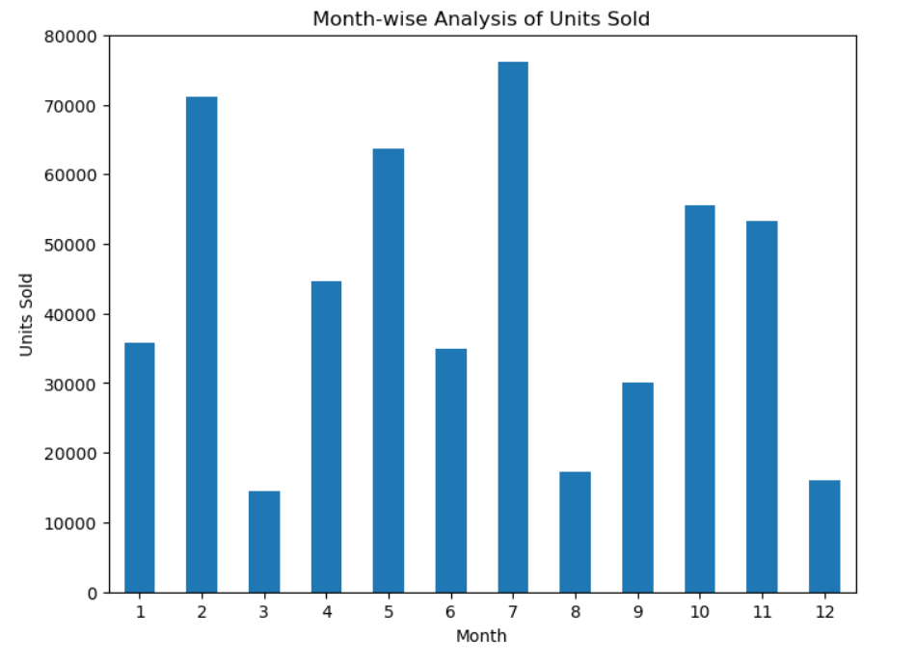
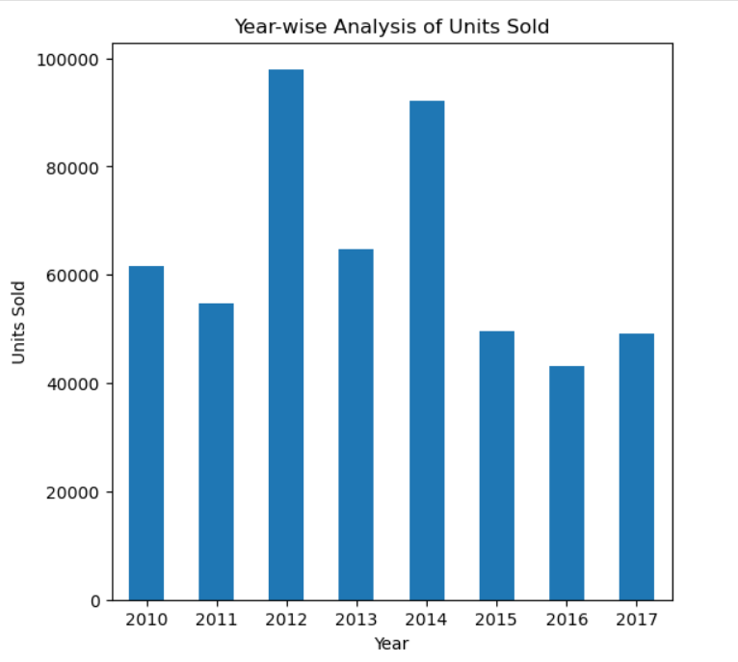
Visualizing Insights with Pandas

Slide 5
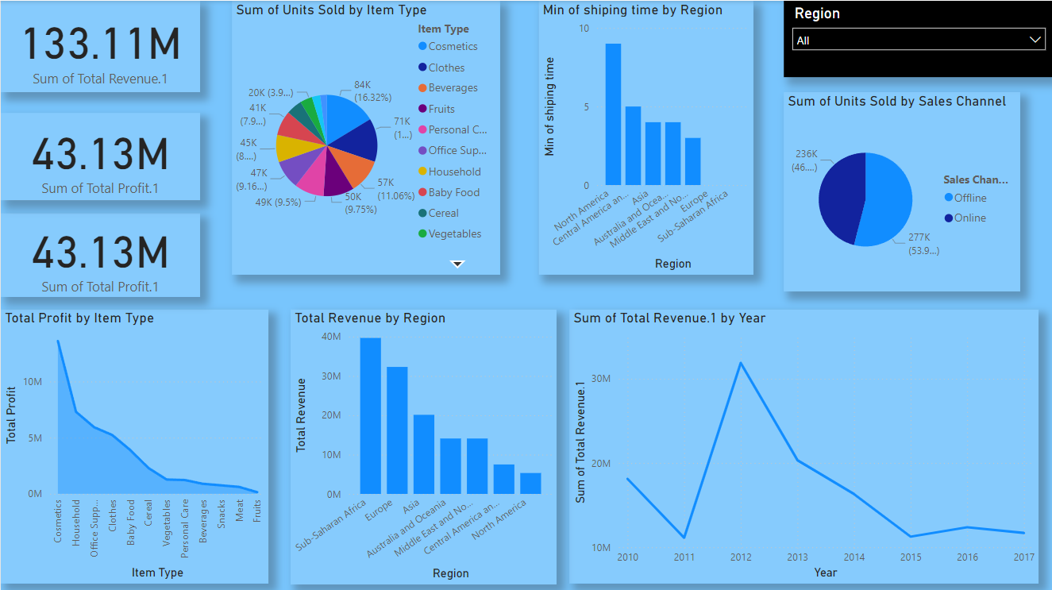
Visualizing Insights with Power BI

Slide 6
INSIGHTS GENERATED
Top 5 Gross Profit Margin Categories:
Cosmetics, Households, Office Supplies, Clothes,
and Baby Food are the top-performing categories in
terms of gross profit margin.
Profit Percentage by Sales Channels:
Online sales contribute to 44% of the total profit,
while offline sales contribute to the remaining 56%
Profit Percentage by Customer Preferences:
High-priority customer preferences generate 38%
of the total profit, followed by the least priority
(25%), medium (22%), and cancels (15%).

Slide 7
THANK YOU!

